Slide 1
Artwork From Crucifixion
By: Lauren M. Jenkins

Slide 2
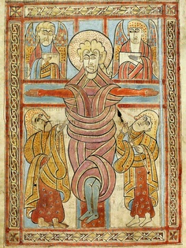
What Is This Piece Of Art?
This piece of artwork is what i’m going to be talking about in this google doc. It was a page of a gospel book. It pictures Christ tied to the stake, and tied to his “People”.

Slide 3
Why?
This artwork was, In my opinion, created to show the thoughts and feelings of the author who painted it. They obviously wanted to show that Christ was tied to his people in more ways than one.

Slide 4
Where?
The painting was found in Stiftsbibliothek St. Gall, Switzerland. (If you try to pronounce it I will laugh so hard I’ll turn purple).

Slide 5
Conclusion
I think this artwork is beautiful in its own way. Most Artwork from the crucifixion is gruesome and bloody, and sad. But this painting is a good example of a knot, and is child appropriate! It also has beautiful colors!
Questions?

