Slide 1
Garden Knot
By. Lanier Evans & Robert Reed

Slide 2
Who uses it?
Knot gardens were first used by English gardeners, but gardeners still use them today.

Slide 3
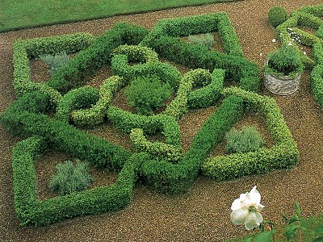
What is it?
A Knot Garden is a specific type of garden with a very formal design with a square frame.

Slide 4
When was it?
Knot Gardens were first made in 1612 in England. It is still used today.

Slide 5
Where was it?
It started in Barnsly, England.

Slide 6
Why was it?
People think that the Knot Garden looks nice. It was also made for the children’s enjoyment.

Slide 7
Discipline
Arts is the discipline.

Slide 8
Citation
Google Images

